Slide 1


WordPress
post types and custom post types

Slide 2


What we are going to learn in this lecture.
WordPress default post types.
Custom post types.
Creating a custom post type.
Querying a custom post type.

Slide 3
WordPress default post types.
1
4
Post.
Page.
Attachment.
Nav Menu

Slide 4
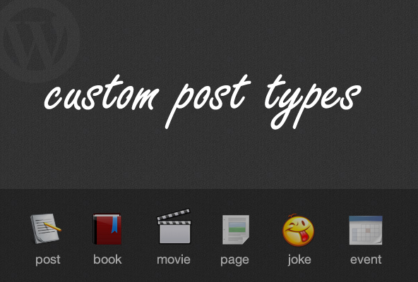
WordPress Custom post types.
2
4

Slide 5
Creating a custom post type.
3
4
Go to your themes functions.php file and write this code.
function my_custom_post_product() {
$labels = array(
'name' => _x( 'Products', 'post type general name’ ),
);
$args = array(
'labels' => $labels,
'description' => 'Holds our products and product specific data’,
'public' => true,
'menu_position' => 5,
'supports' => array( 'title', 'editor', 'thumbnail', 'excerpt', 'comments' ), 'has_archive' => true,
);
register_post_type( 'product', $args );
}
add_action( 'init', 'my_custom_post_product' );

Slide 6
Querying a custom post type.
4
4
Go to your themes functions.php file and write this code.
$args = array(
'post_type' => 'movies’,
'posts_per_page' => 10
);
$post = get_posts($args);
// loop through custom posts
foreach($post as $val){
echo $val->title;
}

